Slide 1

S.T. MOVIES
ID : 2116060201
Advisors: 1. Santa Maria Shithil
Lecturar ( Dept. of CSE )
Victoria University of Bangladesh.

Slide 2
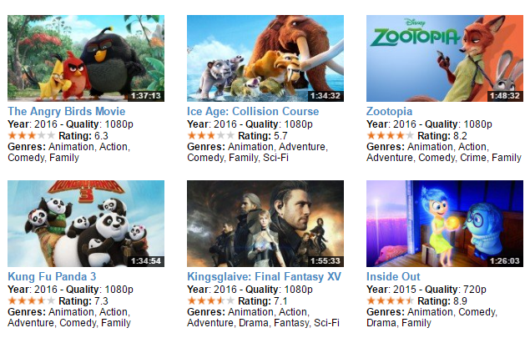
Introduction of the system
This system is so much useful to watch and search one’s favorable movies .

Slide 3
Applications
Part-1
We can find out Movies from here :
Search.
Home.
Recent movies.
Hit movies.
Search by Year.
Search Year to Year
Search by Genres.
Search by Country
Search by Language
Search by Rating
Search from Rating to Rating

Slide 4
Applications
Part-2
We can find out from here :
12. Most viewed movies.
13. Most Rating movies.
14. Search particularly Genres and Country .
15. Search particularly Genres and Raring .
16. Search particularly Genres and Language .
17. Search particularly Country and Rating.
18. Beast Bangladeshi movies.
19. Most expensive movies.
20. Most business full movies.
21. Most viewed any Country movies.

Slide 5
Features
This system will save our time tremendously.
We will be able to find any kinds of Movies .
This system will help to find any Movies in several ways.
People can search their movie in 21 ways.

Slide 6
Platform
Database Type : File
Compiler : CodeBlocks ( GNU/GCC )
Processor : AMD FX(TM)-6100 Six Core Processor @ 3.30GHz
Ram : 4.00 GB (3.50 GB Usable)
Rom : 500 GB
Operating System : Windows 7 professional.
System Type : 64-bit Operating System, x64-based processor
Language : C++

Slide 7
Demo
Please open the MOVIE_DB.cpp file from your computer and run it.

Slide 8
Trouble Shooting
1. We need to take 1. #include<string.h> 2 . #include<conio.h>
3.#include<stdlib.h> as another header file as we need to compare many objects.
2. We have to save those before build the program.
3. An integer type variable should not be compared with a float type variable and an integer or float type variable should not be compared with a char type variable .
4. .txt file must be saved in the same folder where the .cpp file is saved.
5. Switch case is not so good for this program.

Slide 9
Future Plan
Planning to update this project using Graphics.
Planning to make a Movie server of my own.
Going to make another project on Server management system.

Slide 10
Acknowledgement
Thanks to our honorable Teacher , Md. Asiful Hossain for giving access to his google drive and giving us a project sample to make our project easier.
Very much thankful to YouTube videos of several channels and links of Google.

Slide 11
Thank You

